Slide 1

GOOD MORNING

Slide 2
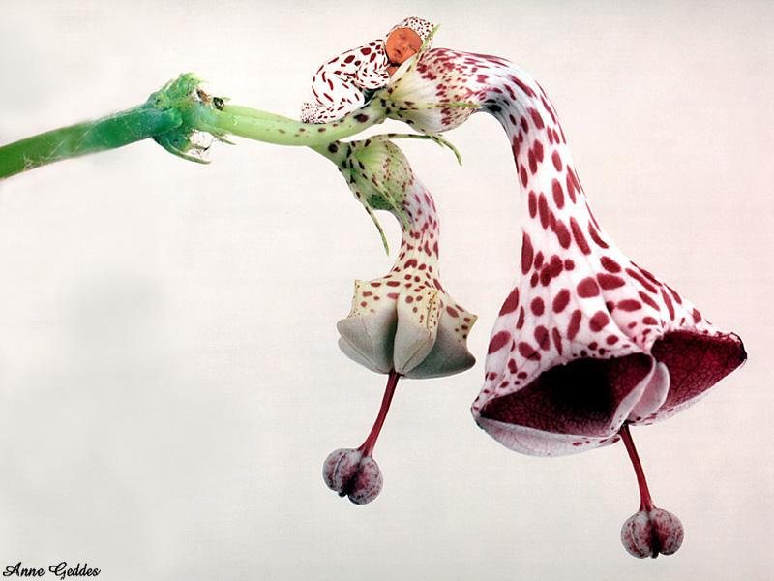
PERIO ENDO LESIONS

Slide 3
CONTENTS
INTRODUCTION
DEFINITION
COMMUNICATION B/W PULP AND PERIODONTIUM
CLASSIFICATION
DIAGNOSIS
ETIOLOGY
MICROBIOLOGY

Slide 4
PERIODONTAL TRAUMA TO PULPAL TISSUES
PULPAL TRAUMA TO PERIODONTAL TISSUES
TREATMENT
DIFFERENTIAL DIAGNOSIS
CONTROVERSIES
STUDIES ON ENDO-PERIO LESIONS
REFERENCES

Slide 5
INTRODUCTION

Slide 6
Endodontic lesion
Periodontal lesion

Slide 7
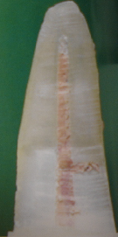
COMMUNICATION BETWEEN THE PULP AND THE PERIODONTIUM
Pathways of developmental origin
  Apical foramen
  Accessory canal and lateral canal
  Congenital absence of cementum exposing the dentinal
  tubules at the cervical region of teeth.
  Permeability of cementum
  Developmental grooves
  Enamel projections and enamel pearls at the cervical area

Slide 8
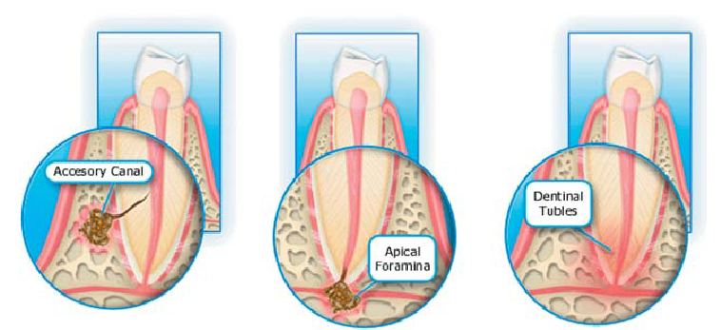

Slide 9
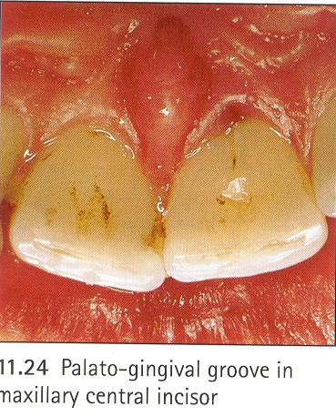
The following anatomical entities or pathways have also been mentioned in the literature as possible causes of periodontally derived endodontic lesions :
Lingual grooves.
Root / tooth fractures.
Cemental hypoplasia.
Root anomalies.
Intermediate bifurcation ridges.
Cervical enamel projections.
Trauma-Induced root resorption.

Slide 10
Pathways of pathological origin
  Empty spaces on the root created by destruction of Sharpey’s fibers
  Vertical tooth fractures
  Idiopathic resorptions – Internal & external
  Loss of cementum due to external irritants

Slide 11
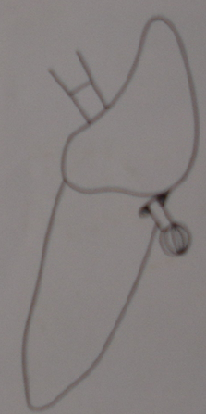
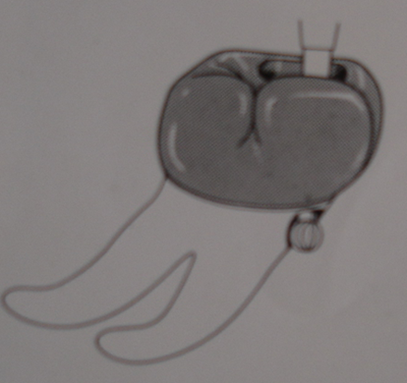
Pathways of iatrogenic origin
  Exposure of dentinal tubules following root planing
  Accidental lateral perforation during endodontic procedure
  Root fracture due to endodontic procedure.

Slide 12
ENDO – PERIO LESIONS
MICROBIOLOGY
-B.FORSYTHUS
-P.GINGIVALIS
-T.DENTICOLA
-FUSOBACTERIA
-SPIROCHETES
-WOLINELLA
-PEPTO STREPTOCOCCUS

Slide 13
DIAGONOSIS

Slide 14

Visual examination
Palpation
Fistula tracking
Percussion
Mobility
Radiograph
Pulp vitality testing
- Cold test
- Heat test
- Electric test
Blood flow test
Cavity test
Cracked tooth testing
-Transillumination
-Wedging
-Staining
Selective anesthesia test

Slide 15


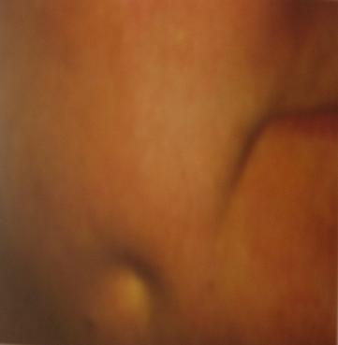
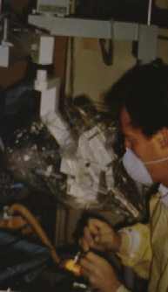
VISUAL EXAMINATION
EXTRA ORAL SINUS TRACT
MAGNIFYING MICROSCOPE

Slide 16

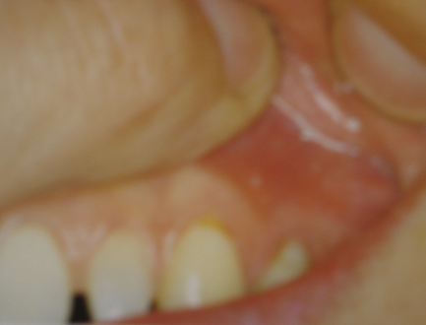
PALPATION

Slide 17
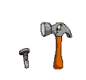

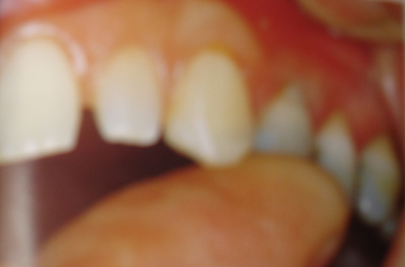
PERCUSSION

Slide 18

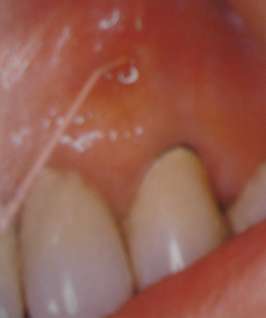
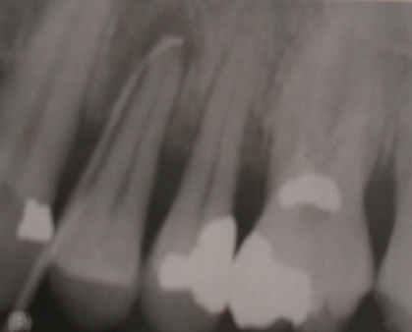
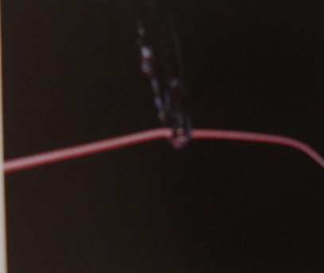
FISTULA TRACKING
GUTTAPERCHA

Slide 19

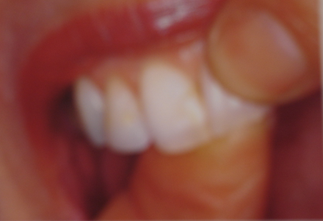
MOBILITY

Slide 20
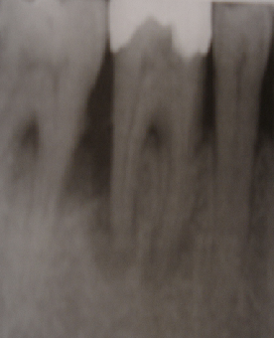
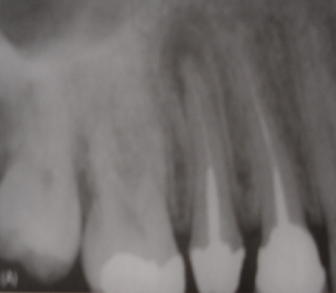
RADIOGRAPH
ALVEOLAR BONE RESORPTION
PERIAPICAL RADIOLUCENCY

Slide 21
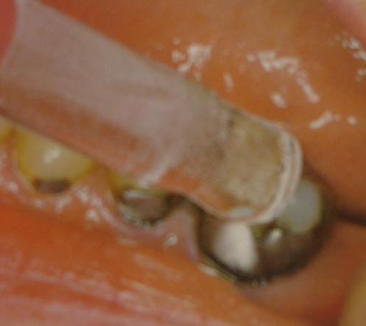
PULP VITALITY TESTING
Cold test:
Performed by applying a cold substance or agent to a well isolated tooth surface.
Eg. Ice sticks,ethyl chloride,carbondioxide (dry ice) -78°C; refrigerants such as dichlorodifluoromethane (DDM) -50°C.
COLD TEST

Slide 22
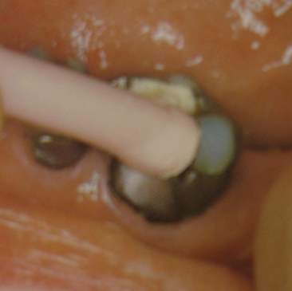
HEAT TEST
Heat test:
Hot gutta-percha should be applied to the teeth coated with petroleum jelly

Slide 23
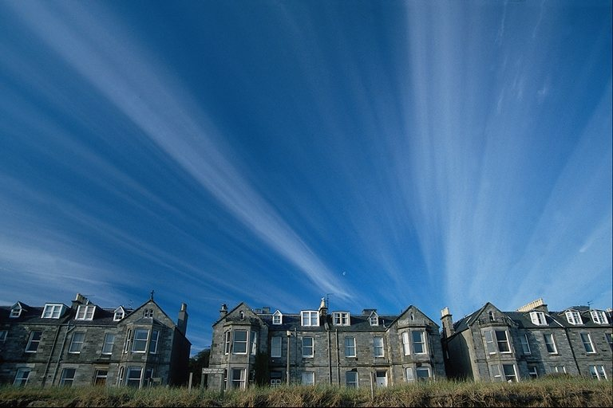
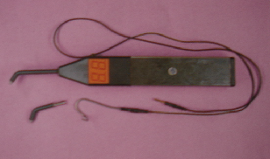
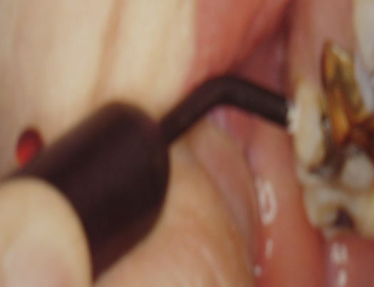
ELECTRIC TEST
ELECTRIC PULP TESTER
    Positive response—intact vital pulp
    No response—Necrotic pulp

Slide 24
BLOOD FLOW TEST
Sensors are applied to the external surface of the crown and the pulp blood flow is recorded and compared to controls.

Slide 25

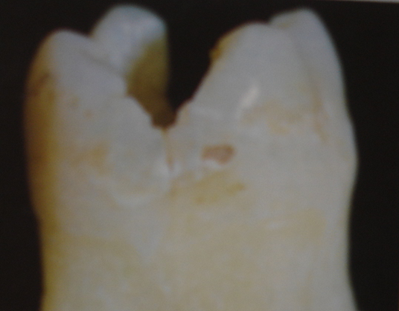
CAVITY TEST
A light speed hand piece with new sharp bur is used to prepare a cavity.
Positive response— presence of vital pulp tissue
No response— Cavity extended into pulp chamber
Reliable in determining the vitality of the pulp

Slide 26
RESTORED TEETH TESTING

Slide 27
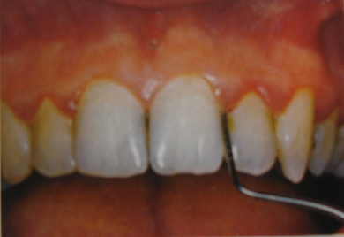
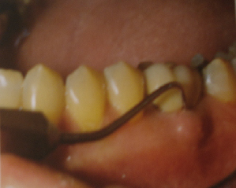
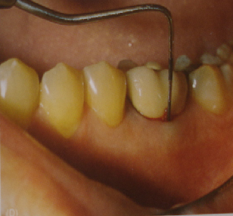
POCKET PROBING

Slide 28

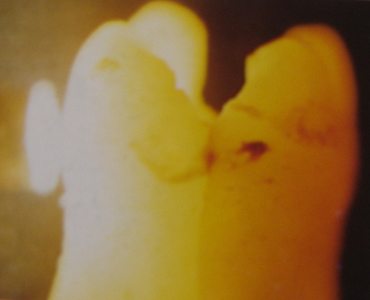
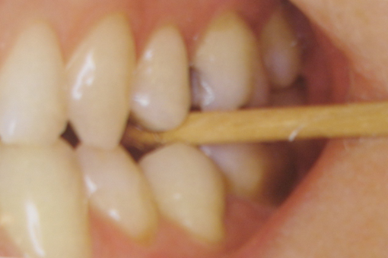
CRACKED TOOTH TESTING
Transillumination:
Wedging:
Staining :

Slide 29
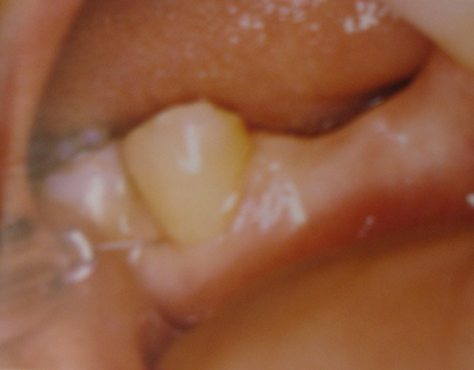
SELECTIVE ANESTHESIA TEST

Slide 30

CLASSIFICATION

Slide 31
CLASSIFICATION OF PERIO-ENDO LESIONS :
According to Simon :1972
Primary endodontic lesion
Primary endodontic lesion with secondary periodontal involvement
Primary periodontal lesion
Primary periodontal lesion with secondary endodontic involvement.
True combined lesion

Slide 32
According to Weine :
Class I : tooth in which symptoms clinically and radiographically simulate periodontal disease but are infact due to pulpal inflammation and/or necrosis.
Class II : Tooth that has both pulpal or periapical disease and periodontal disease concomitantly.
Class III : Tooth that has no pulpal problem but requires endodontic therapy plus root amputation to gain periodontal healing.
Class IV : Tooth that clinically and radiographically simulates pulpal or periapical disease but infact has periodontal disease.

Slide 33
Classification based on treatment procedures given by Oliet and Pollock
Lesion that require Endodontic procedures only
Lesions that require periodontal treatment procedures only
Lesions that require combined endodontic-periodontic treatment procedures

Slide 34

TREATMENT

Slide 35
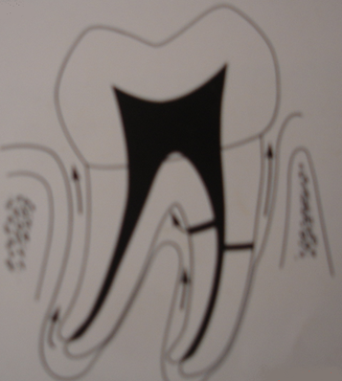
PRIMARY ENDODONTIC LESION :

Slide 36
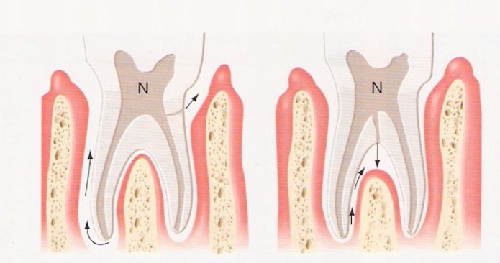

Slide 37
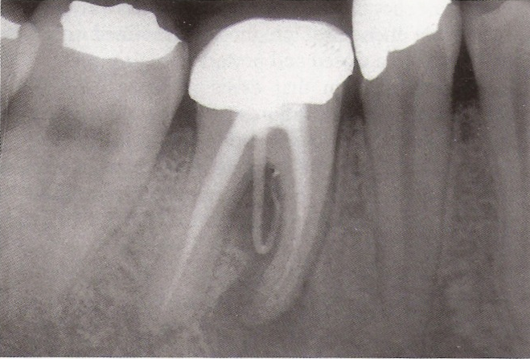
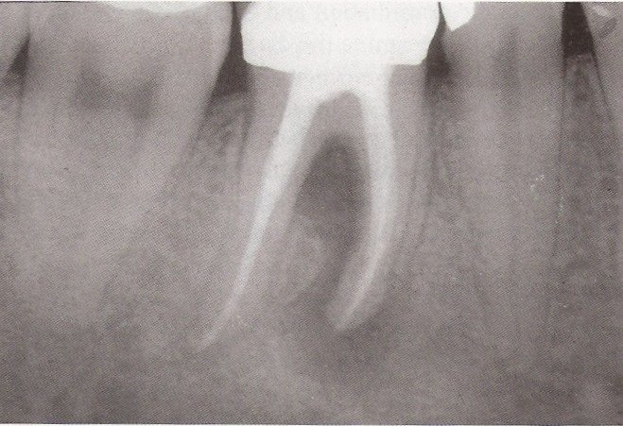
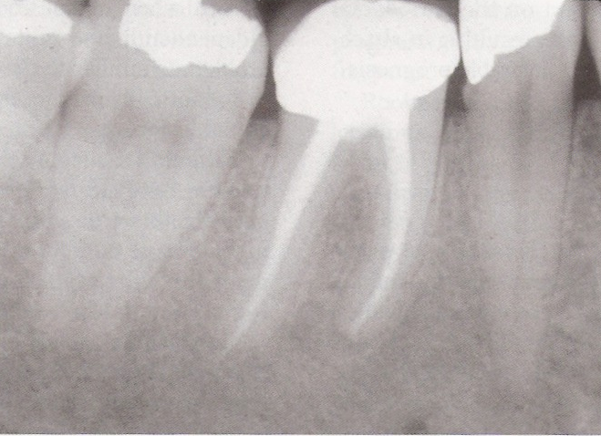

Slide 38
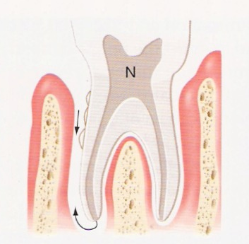
PRIMARY ENDODONTIC LESION WITH SECONDARY PERIODONTAL INVOLVEMENT :

Slide 39
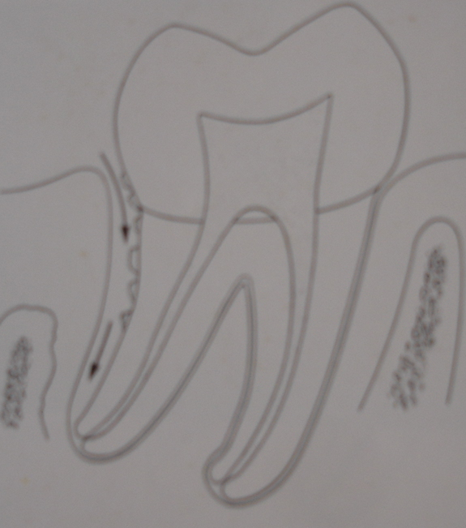
PRIMARY PERIODONTAL LESION :

Slide 40
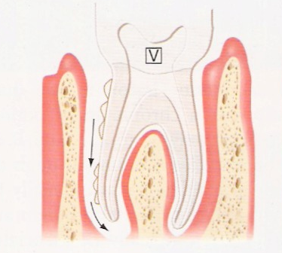
PRIMARY PERIODONTAL LESION WITH SECONDARY ENDODONTIC INVOLVEMENT :

Slide 41
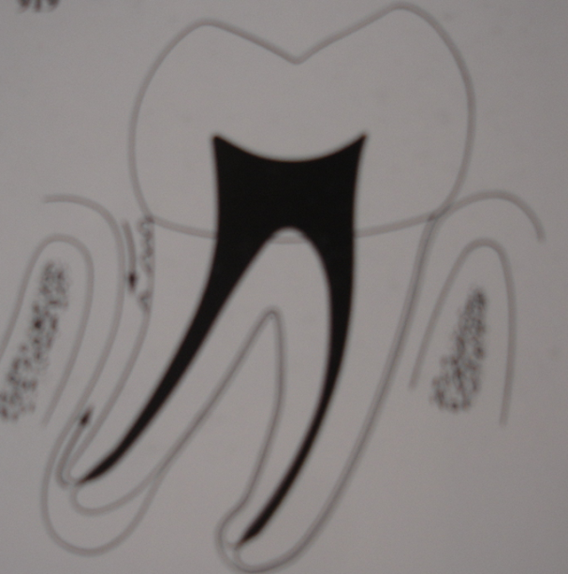
TRUE COMBINED LESION :

Slide 42
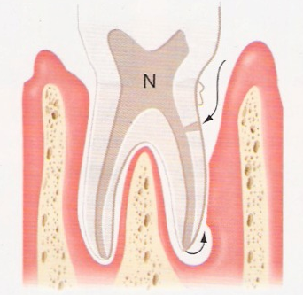

Slide 43
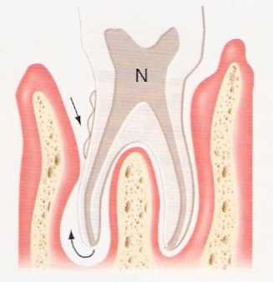

Slide 44
ALTERNATIVE TREATMENT MODALITIES :
Indications for Radisectomy
Indications for Hemisection :

Slide 45
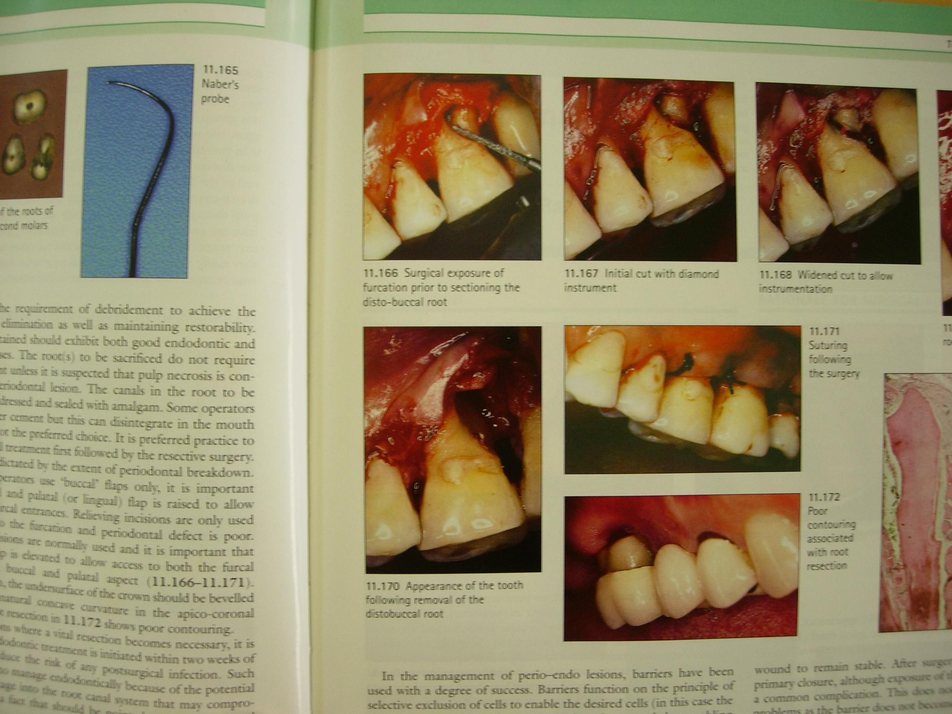

Slide 46
DIFFERENTIAL DIAGNOSIS OF PULPAL AND PERIODONTAL LESIONS :
 | Pulpal | Periodontal
Clinical
Cause | Pulp infection | Periodontal infection
Vitality | Nonvital | Vital
Restorative | Deep or extensive | Not related
Plaque / calculus | Not related | Primary cause
Inflammation | Acute | Chronic
Pockets | Single, narrow | Multiple,wide coronally
pH value | Often acid | Usually alkaline

Slide 47
Radiographic
Pattern | Localized | Generalized
Bone loss | Wider apically | Wider coronally
Periapical | Radiolucent | Not often related
Vertical bone loss | No | Yes
Histopathology
Junctional epithelium | No apical migration | Apical migration
Granulation tissues | Apical (minimal) | Coronal (Larger)
Gingival | Normal | Some recession
Therapy
Treatment | Root canal therapy | Periodontal treatment
Pulpal
Periodontal

Slide 48
Thank you

